Slide 1

Screening, Brief Intervention and Referral to Treatment
Barbara Keehn BSN, RN
Project Director

Slide 2
Substance Abuse Mental Health Services Administration
Applicant: Office of the Governor
Lead Agency: Department of Mental Health, Division of Alcohol and Drug Abuse
Administered by the Missouri Institute of Mental Health

Slide 3
National SBIRT sites
2003
California
Illinois
New Mexico
Pennsylvania
Texas
Washington
2008
Alaska
West Virginia
Missouri
Georgia
2011
Indiana
North Carolina
Tennessee
Illinois
Colorado
Connecticut
American Samoa
New York
Washington
2006
Colorado
Florida
Massachusetts
Wisconsin

Slide 4
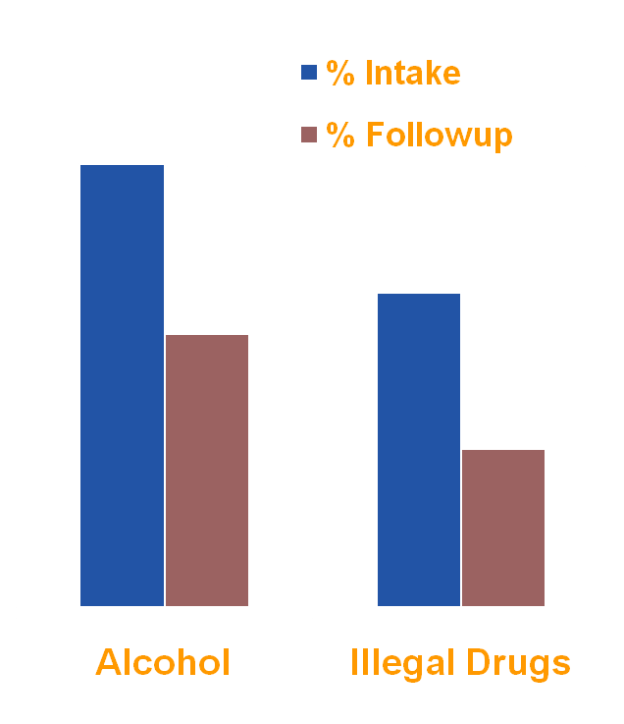
National SBIRT Accomplishments
Alcohol use to level of intoxication
  (5+drinks) declined 38%
Use of any illicit drugs decreased
  50%
Nearly 50% of those who have a
  brief intervention changed their
  patterns of misuse
N=11 States

Slide 5
Current Locations
Columbia
St. Louis
Springfield
St. Louis
Grace Hill
Neighborhood Clinics
Columbia
University Hospital ER
Univ. of MO Student Health
Family Health Center
MO Psychiatric Center
Springfield
Cox North ER
Cox South ER
Skaggs ER
Citizen’s Memorial ER

Slide 6
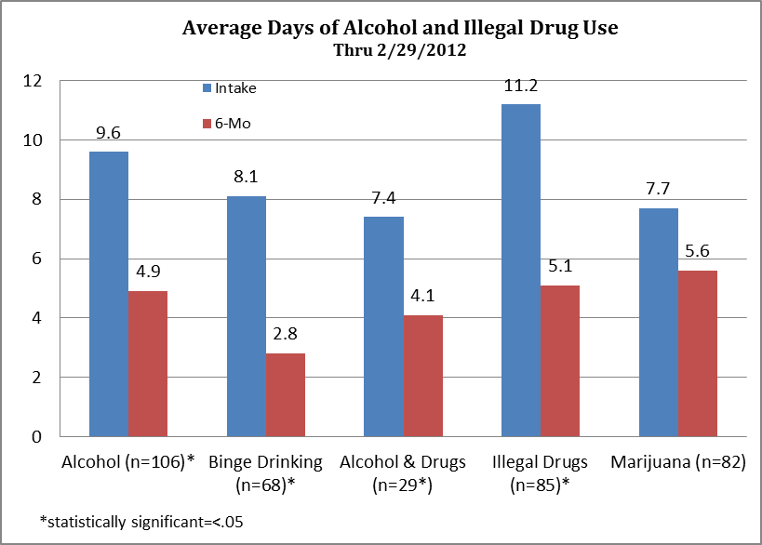
MOSBIRT Patient Outcomes (N=124)
(Based on 6 month follow-up of days used substances in past 30 days)

Slide 7
MOSBIRT Patient Satisfaction (N=175)
(Based on 5 point scale 1=Strongly disagree to 5=strongly agree)

Slide 8
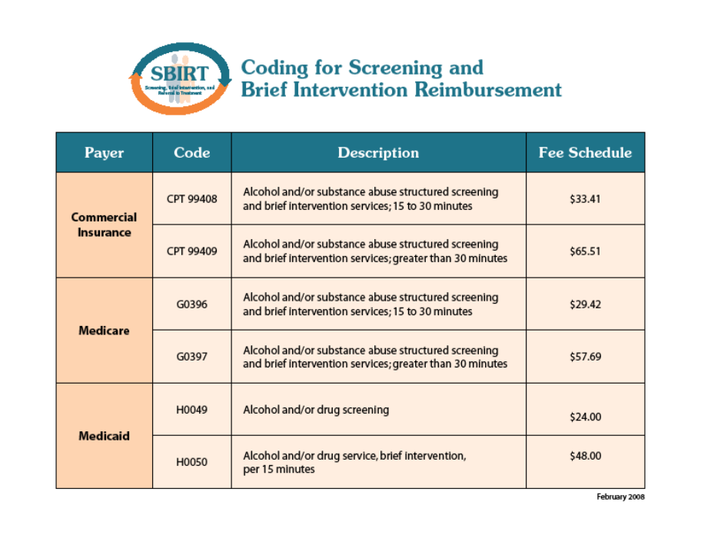
Billing Codes

Slide 9
Question and Answer Conference Call
Friday, April 20, 2012
9 a.m.-11 a.m.
Toll Free 1-866-630-9352
Regional Trainings-Motivational Interviewing and Brief Coaching
Jordan Valley-Springfield April 26-27
People’s Clinic-St. Louis May 1-2
Primary Care Assoc.-Jeff City May 9-10
Sam Rogers-Kansas City May 22-23

