Slide 1
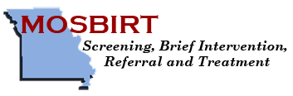
SBIRT:
Screening, Brief Intervention and Referral to Treatment
Overview, Epidemiology and Evidence

Slide 2

Learning Objectives
Module One: Orientation to SBIRT
Know the purpose and basic elements of SBIRT
Know the prevalence and negative health consequences of alcohol and other substance misuse
Know some of the obstacles to implementing SBIRT in general health care
Know evidence for the effectiveness of SBIRT in health care settings
Notes:
2

Slide 3
What is SBIRT?
SBIRT is an evidence based program for addressing risky substance use and is designed to be integrated into general medical and other community settings. SBIRT =
Screening
Brief Intervention
Referral for Treatment

Slide 4
Key elements of SBIRT
SBIRT is based on a public health model:
  Population based screening –
    everyone is screened, not just the patients who “look like” they have a substance use problem or report one.
  Emphasis on prevention, early detection and early intervention
    Traditional treatment focuses on substance abuse disorders which often are not detected until advanced stages or serious adverse events.
Brief interventions use Motivational Interviewing principles and techniques vs. more typical prescription to change.

Slide 5
Treatment as Usual

Slide 6
What is risky substance use?
Alcohol
For men up to age 65:
  More than 4 drinks in one day and/or more than 14 drinks/week
For women, and for men over 65:
  More than 3 drinks in one day and/or more than 7 drinks/week
  Prescription misuse and illicit drugs
  Any Rx misuse or illicit drug use at any age by men or women
  Tobacco Use
  Any tobacco use

Slide 7
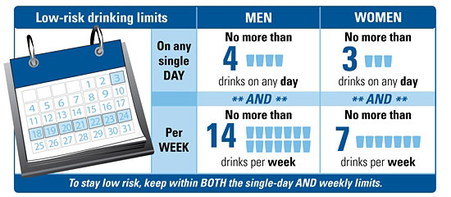
National Institute on Alcohol Abuse and Alcoholism (NIAAA)
Low Risk Drinking Limits

Slide 8
The SBIRT Process
Annual Brief Screen for All Patients
+
Assessment of Severity
+
+
+
Mild Risk
Brief Education
Moderate Risk
Brief Coaching
High Risk
Brief
Education and
Referral for
Treatment

Slide 9
This training is focused on Brief Education which is the most common intervention you will provide.
A second round of regional trainings will cover Motivational Interviewing in more depth, Brief Coaching and Referral.

Slide 10
Why is SBIRT Important to Us?
Substance misuse is common, deadly and treatable.
The attention we give to substance misuse is not proportional to its prevalence, relevance to general health and our ability to intervene effectively.

Slide 11
Prevalence of Alcohol Misuse in Medical Settings
Dependent
At-Risk Drinkers
Low Risk Drinkers
Abstainers
Notes:
11

Slide 12
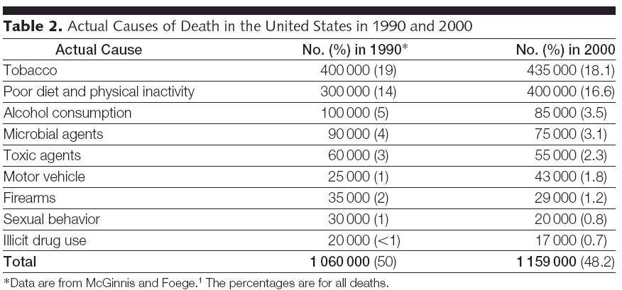
Leading Causes of Preventable Death in the United States

Slide 13
Morbidity and Mortality
107,000+ | Alcohol related deaths each year
33% | Adult Emergency Department admissions are alcohol related.
60% | Trauma center patients are under the influence of alcohol and/or drugs.
2X | Injury events/year for problem drinkers
4X | Hospitalizations/year for problem drinkers
Increased Risk | Heart and liver disease, hypertension, gastritis/PUD, seizures, stroke and psychiatric disorders

Slide 14
Relevance of Substance Use Screening to Clinical Practice
Provides the opportunity for early detection and intervention for risky substance use to prevent health problems and progression to substance abuse
Provides the opportunity to reinforce low risk substance use
Can help with medical management of individual cases where alcohol, drug or tobacco use may be a risk factor

Slide 15
Why General Medical Settings?
(Isn’t this someone else’s problem?)
General health care settings such as primary care and emergency departments are gatekeepers for the health care system.
Health care encounters are often teachable moments when patients are more likely to listen and think about their health.
Alcohol and drug misuse are major preventable causes for disease and injury.
Specialized substance abuse services are segregated from general health care, difficult to access and focus on substance use disorders and not the much more common at risk drinking.

Slide 16
Obstacles to SBIRT in General Care
Tradition
Attitudes
Knowledge
Beliefs
Time

Slide 17
The Provider – Patient Perspective Paradox
Research indicates that many of the reasons providers offer for not addressing substance use issues reflect their own concerns and are not consistent with patient attitudes and expectations.

Slide 18
Clinician self-reported barriers to discussing alcohol with patients
57.7% Belief that patients lie
35.1% Time constraints
29.5% Fear it questions patient’s integrity
25% Fear of frightening/angering patient
15.7% Uncertainty about treatments
12.6% Personally uncomfortable with subject
11% May encourage patient to see other MD
10.6% Insurance doesn’t reimburse PCP time
Notes:
“Lying to physicians is not restricted to the problem of substance abuse. Patients frequently lie about eating habits, sexual practices and medical compliance. This does not necessarily mean that physicians do not discuss these issues with patients.”
-CASA report

Slide 19
But Patients Say…..
 | Agree/Strongly Agree
“If my doctor asked me how much I drink, I would give an honest answer.” | 92%
“If my drinking is affecting my health, my doctor should advise me to cut down on alcohol.” | 96%
“As part of my medical care, my doctor should feel free to ask me how much alcohol I drink.” | 93%
 | Disagree/Strongly Disagree
“I would be annoyed if my doctor asked me how much alcohol I drink.” | 86%
“I would be embarrassed if my doctor asked me how much alcohol I drink.” | 78%
Notes:
Patient attitudes towards self-report and biomarker alcohol screening by primary care physicians.
Miller PM, Thomas SE, Mallin R.
Alcohol Alcohol. 2006 May-Jun;41(3):306-10. Epub 2006 Mar 30.
Study participants were recruited from an outpatient primary care clinic located in downtown
Charleston, SC, adjacent to a medical university. The clinic provides primary care medical
services to a mostly black, lower socioeconomic, female population
who are covered by Medicaid.

Slide 20
Check Your Own Assumptions
  Your beliefs about substance use and your role in addressing it can have a powerful influence on your effectiveness with patients. See if any of these sound familiar.
Substance abuse is a moral failing, not a medical issue.
Treating substance misuse is not my job.
My job is to diagnose and advise treatment – take it or leave it.
My patient should be ready to change.
A patient’s health should be their prime motivation.
If my patient doesn’t change, the brief intervention has failed.
Patients are either motivated or not.
Now is the right time to change.
A tough approach is best.
I am the expert and they should follow my advice.

Slide 21
Is SBIRT Effective?

Slide 22

Evaluations of SBIRT
  Meta-analyses & reviews:
      More than 34 randomized controlled trials
      Focused primarily on at-risk and problem drinkers
      Result: 10-30% reduction in alcohol consumption at 12 months
Notes:
Moyer A, Finney JW, Swearingen CE, Vergun P. Brief interventions for alcohol problems: a meta-analytic review of controlled investigations in treatment-seeking and non-treatment-seeking populations. Addiction. 2002 Mar;97(3):279-92. Review.
Moyer A, Finney JW. Outcomes for untreated individuals involved in randomized trials of alcohol treatment. J Subst Abuse Treat. 2002 Oct;23(3):247-52. Review.
Moyer A, Finney JW. Randomized versus nonrandomized studies of alcohol treatment: participants, methodological features and posttreatment functioning. J Stud Alcohol. 2002 Sep;63(5):542-50. Review.
Moyer A, Finney JW, Swearingen CE. Methodological characteristics and quality of alcohol treatment outcome studies, 1970-98: an expanded evaluation. Addiction. 2002 Mar;97(3):253-63. Review
Whitlock EP, Polen MR, Green CA, Orleans T, Klein J; U.S. Preventive Services Task Force. Behavioral counseling interventions in primary care to reduce risky/harmful alcohol use by adults: a summary of the evidence for the U.S. Preventive Services Task Force. Ann Intern Med. 2004 Apr 6;140(7):557-68.
Bertholet N, Daeppen JB, Wietlisbach V, Fleming M, Burnand B. Reduction of alcohol consumption by brief alcohol intervention in primary care: systematic review and meta-analysis. Arch Intern Med. 2005 May 9;165(9):986-95. Review.

Slide 23
SBIRT in Primary Care
Brief physician advice for problem alcohol drinkers: a randomized control trial in community-based primary care practices
  SBIRT in 17 practices with 64 physicians
  Intervention included: educational workbook, two15 minute visits one month apart and two nurse follow-up calls, 2 weeks after the visit
Results: Significant decreases in binge drinking and weekly usage.

Slide 24
SBIRT in Trauma Centers
  Patients who tested and/or screened positive for alcohol problems were randomly assigned to SBIRT treatment or control groups. Treatment consisted on one brief education/motivational interviewing intervention.
  Results at one year:
      SBIRT group decreased alcohol consumption
      Reduction most apparent in mild-moderate drinkers:
      47% reduction in new injuries requiring Emergency Department visit or readmission to the trauma service
      Results at three years:
      48% reduction in new injuries requiring hospitalization

Slide 25
Partnership for Prevention Ranking Ten Most Effective Prevention Services
Discuss daily aspirin use
Childhood immunizations
Smoking cessation advice and help to quit
Alcohol screening and brief counseling
Colorectal screening
Hypertension screening and treatment
Influenza immunization
Vision screening
Cervical cancer screening
Pneumococcal immunizations

Slide 26

Take Home Points
The prevalence rate for risky drinking in medical settings is around 25%.
Risky substance use is far more prevalent at 20% than substance use disorders at 5%.
There are many medical, psychiatric and social consequences of risky alcohol and other substance use.
Providers often do not recognize substance misuse and miss opportunities to intervene even though patients would generally be receptive to this.
Screening and brief interventions for risky alcohol and other substance use are efficient and effective.

