Slide 1

Brief Education for Hazardous Substance Use

Slide 2

Training Objectives
Know how to introduce risky substance use as a health concern.
Know the key steps in a brief education.
Know several tools and techniques for enhancing motivation.
Know how to negotiate an acceptable and effective follow-up plan with the patient.

Slide 3
Levels of Care
ASSIST Total Score | Level of Risk | Treatment
0-10 for alcohol 0-3 for drugs | Low Risk | Reinforcement and Education
11-19 for alcohol 4-19 for drugs | Low Moderate Risk | Brief Education
20-26 for any substance | High Moderate Risk | Brief Coaching
27+ for any substance | High Risk | Referral to Treatment

Slide 4
Question
How many health care providers does it take to change a light bulb?

Slide 5
Answer(s)
None. The light bulb has to want to change.
None. The light bulb will change itself when it is ready.
Only one but the light bulb has to really want to change!

Slide 6
Treatment as Usual

Slide 7
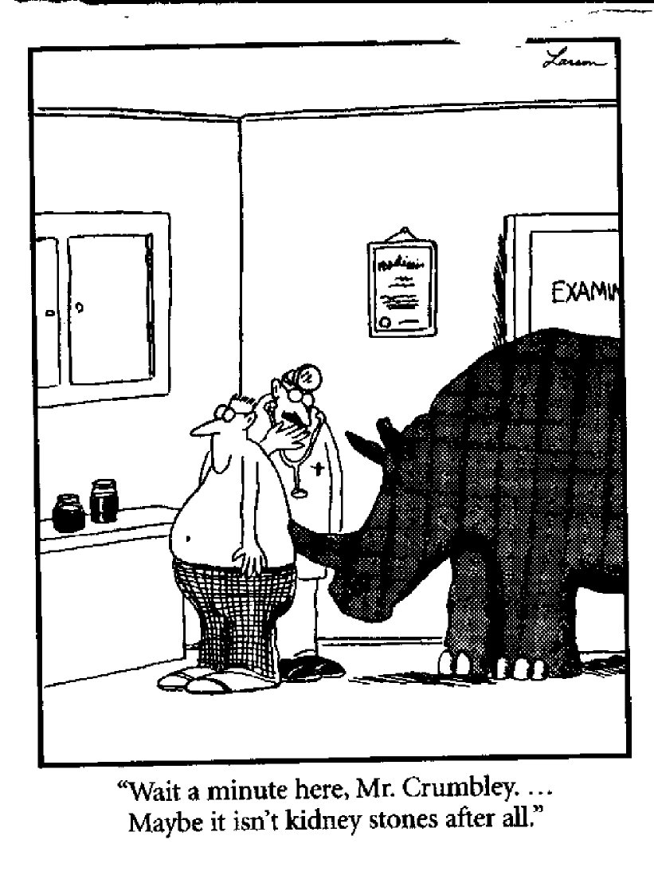

Slide 8
Brief Education Steps
Brief intervention
1. Raise the subject
2. Provide feedback
3. Offer Advice
4. Enhance motivation
5. Negotiate a plan

Slide 9
Brief intervention
1. Raise the subject
  Screening results serve as a convenient way to start the conversation.
  Ask permission to talk about the patient’s substance use
  For example:
    Thanks for answering our screening questions. Would you mind taking a few minutes to talk with me about your alcohol use?
    Your provider asked me to talk with you about your marijuana use. She has some concerns about how that might affect your health. Would it be ok if we talked about it?
Notes:
This step sets the tone of respect and collaboration.
Key Components
Be respectful
. Obtain permission from the client to discuss his or her substance use
Avoid arguing or confronting the client. If the patient does not want to discuss it accept his or her decision. Don’t push; it may build resistance to discussing it in the future with others who may also broach the topic.
Objectives
Establish rapport
Asking permission helps to establish a sense that the patients concerns and wishes are central to the intervention.
Option
Show the short clip from the Emergency Room Physicians SBIRT site on “how not to do it”

Slide 10
Anticipate Patient Questions/Reactions
Patients may question why you are asking about substance use:
Positive findings from the screening and assessment may trigger challenges, resistance, denial, guilt, shame, or anger. Negative reactions can usually be deflected by acknowledging the feelings and avoiding confrontation.
  We ask everyone about alcohol and drug use because it can affect your health.
  Sometimes health problems can occur at what many people think are safe levels of use.
  I can see this is upsetting to you. Let’s talk about it.
  If you would rather not discuss this now, maybe we can pick it up on your next visit. It’s your choice.
Notes:
Who assist 2003
10

Slide 11
Brief intervention
2. Provide feedback
  The Personalized Feedback Report (PFR) is generated and individualized based on the patient’s responses to the assessment.
  Providing a printed copy makes a convenient prop to start a difficult discussion and gives the patient something to take home and consider.
  The PFR provides a summary of the health effects associated with the patient’s self reported substance use as well as a reflection of their readiness to change.
Notes:
Key Components
Review current drinking patterns
Make any connections between alcohol/drug use, other health problems (if applicable) and this visit
Objectives
Review client’s drinking patterns (express concern and be non-judgmental)
“From what I understand you are drinking… (state the amount) and you indicated you have felt guilty about your drinking.”
Do you have any concerns about your drinking?
2. Help the patient make any connections between substance use and other health problems or other life problems (DUI, relationship issues)
Start with eliciting from them whether they see a connection before you make the connection for them.
“What connection (if any) do you see between your drinking and your hypertension?”
If the client sees a connection, review what he or she has said. Reflect
3. Compare their use to NIAAA drinking guidelines. Show the NIAAA Guidelines for Low-Risk Drinking
“Your score of 12 indicates your drinking falls in the “at-risk” zone – about here – which means your health may suffer. For the sake of your health you really should get down to the low-risk level.” “Would you like to do something about this?” Have you ever been concerned about your drinking?”
This step is important to motivate clients to think about their drinking patterns and consider making changes.
Might refer to how this creates a discrepancy especially if they fall in the Hazardous category and they thought they were only “light” drinkers.

Slide 12
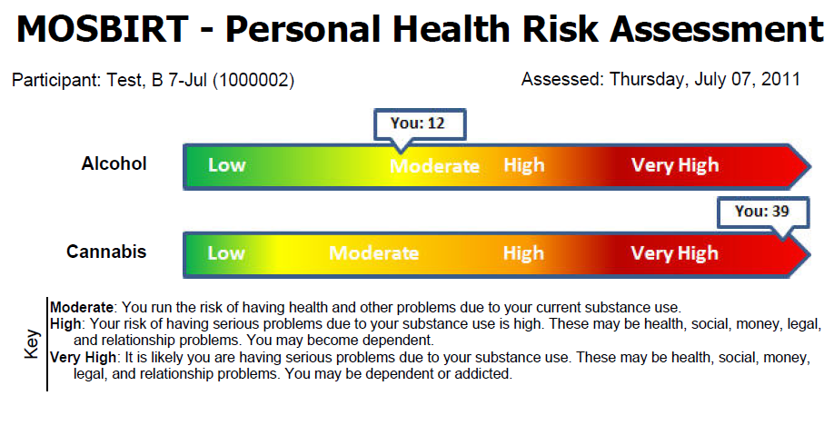

Slide 13
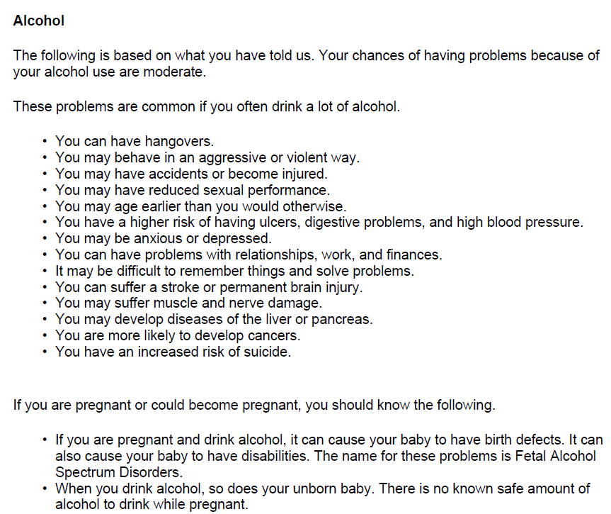

Slide 14
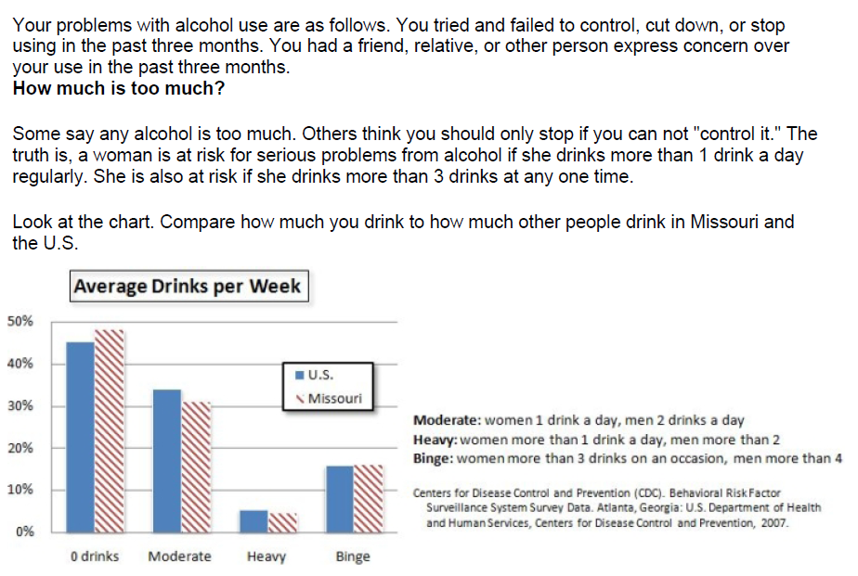

Slide 15
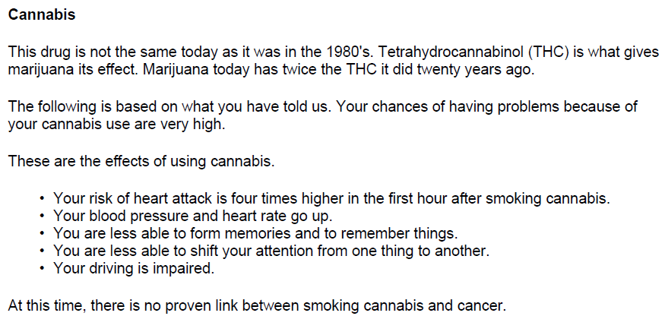
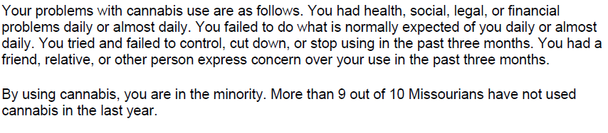

Slide 16
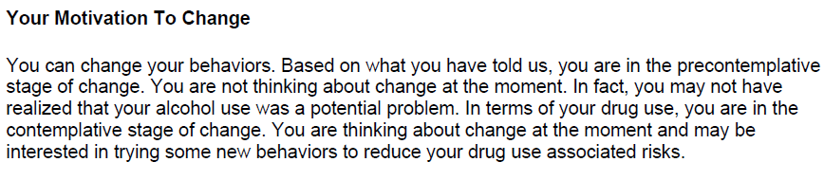

Slide 17
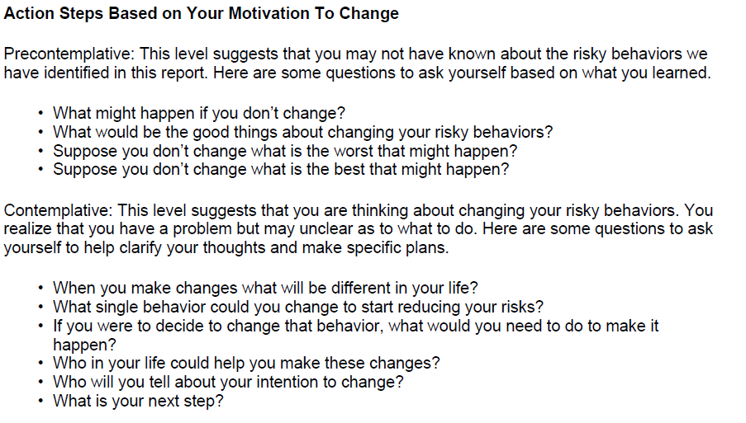

Slide 18
3. Offer Advice
Ask permission to offer advice
Provide advice that is appropriate to the severity of the problem.
Offer a range of options. Patients who are presented with choices are more likely to change.
  A harm reduction approach can be effective as an interim step for patients with more serious problems or even a goal for patients with more moderate misuse.
  Other choices could include self-monitoring, looking at some educational materials, getting feedback from family and friends.
  I would like you to consider cutting down.
  Your drinking is causing problems. Maybe you should consider cutting down or even quitting.

Slide 19
Three Openings to Offer Advice
The person asks for advice
You ask permission to give advice:
You qualify your advice to emphasize autonomy:
    Can I make a suggestion?
    Would you be interested in some resources?
    Would you like to know what has worked for some other people?
    A lot of people find that _____works well, but I don’t know if that’s something that interests you.
Notes:
Even when the person asks for the advice, it’s important not to jump in if you feel that they are not ready or insincere. It’s okay to ask permission to get more information BEFORE giving advice, “You know, that’s cetainly something I can do, but I’m wondering if I really have enough information about the problem to really give you good advice right now. Would you mind telling me a little bit more about the situation? How do you feel about giving up marijuana?... “
“Can I make a suggestion?”
“Would you be interested in some resources?”
“Would you like to know what has worked for some other people?”)
A lot of people find that _____works well, but I don’t know if that’s something that interests you.”

Slide 20
  Use tools and techniques that help the patient resolve ambivalence and build motivation
4. Enhance motivation
Tools
Techniques
Decisional balance worksheet
Readiness Ruler
Self evaluation ruler
Informational handouts
Online resources
OARS
Rolling with resistance
Elicit change talk

Slide 21
Key Concepts
Brief intervention is based on two interrelated and critical elements:
Stages of Change
Many people go through various stages before they are ready to make important changes in their behavior. Recognizing and addressing where patients are in the process is critical to facilitating behavior change.
Motivational Interviewing
MI is a set of intervention techniques to help patients move through stages of change and develop their own internal motivation. It is also a philosophy of care that recognizes and respects individual autonomy and self determination.

Slide 22
Transtheoretical Model of Behavior Change
Described by James 0. Prochaska, Ph.D. & Carlo C. DiClemente, Ph.D.
The Transtheoretical Model identifies 5 stages of change people may go through in the process of changing problem behavior:
  Precontemplation
  Contemplation
  Preparation
  Action
  Maintenance
Interventions are most effective when they are geared to the patient’s current stage.
Change is understood as a process rather than an event; as a series of changes, not just one.

Slide 23
Stages of Change Model
Stage | Definition
PRECONTEMPLATION | Patient is not considering change in the near future May or may not know the potential health consequences of continued substance use
CONTEMPLATION | Patient may be aware of the consequences of substance use but is ambivalent about changing
PREPARATION | Patient has already decided to change and plans to take action
ACTION | Patient has begun to cut down or stop use Change has not become a permanent feature
MAINTENANCE | Patient has achieved moderation in substance use or abstinence on a relatively permanent basis

Slide 24
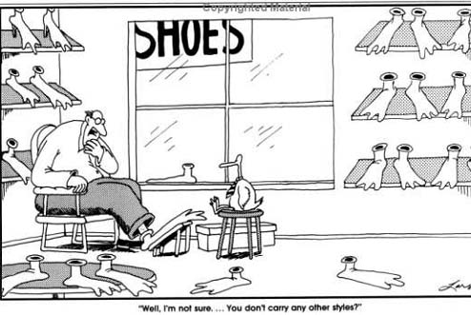

Slide 25
How Do People Change?
  People change voluntarily only when they:
  Become interested in or concerned about the need for change
  Become convinced that the change is in their best interest or will benefit them more than cost them, i.e., the decisional balance shifts to favor change
  Organize a plan of action that they are committed to implement
  Take the actions that are necessary to make the change and sustain the change.

Slide 26
Motivational Interviewing
Motivational Interviewing (MI) is a directive, patient-centered counseling style for eliciting behavior change by helping patients to explore and resolve ambivalence about change.
MI recognizes that patients may be at different stages of awareness and readiness to change.
The central goal of MI is to increase the intrinsic motivation to change that arises from internal forces rather than external pressures.

Slide 27
Introspective Exercise
Think about a behavior that you’ve been successful at changing.
Something you’ve had to change in your life
Notes:
7
Think about a behavior that you’ve been successful at changing. Something you’ve had to change in your life – don’t tell, but think about it.

Slide 28
How long did it take for you to decide it was a problem?
< 1 mo.
1 to 6 mo.
7 to 12 mo.
One to two years
3 to 5 yr.
> 5 yr.
Notes:
9
1) How long was it between the first time you engaged in that behavior and the first time you had a negative consequence as a result of the behavior; or became aware that the behavior was risky?
2) How long between the first time you had a negative consequence/realized it was risky and first made an attempt to change the behavior?
3) After you first made an effort to change the behavior, did you start the behavior again?
4) How long between that first attempt and when you actually were successful in changing?

Slide 29
How long between the first time you had a negative consequence/realized it was risky and first made an attempt to change the behavior?
After you first made an effort to change the behavior, did you start the behavior again?
How long between that first attempt and when you actually were successful in changing?

Slide 30
Conclusions about behavior change?
Notes:
13

Slide 31
Behavioral issues are common
Change often takes a long time and the pace of change is variable
Knowledge is usually not sufficient to motivate change
Recurrence or relapse is the rule
Our expectations of others regarding behavior change are often unrealistic
Unrealistic expectations can lead to frustration and burn-out
Notes:
14

Slide 32
Summary
MI puts all this into perspective
We’ve ALL tried to change behaviors!
There is no us vs. them

Slide 33
MI Spirit
Motivational Interviewing is both a philosophy and set of techniques and skills. The philosophy is embodied in MI Spirit which includes four core values:
Collaboration - The patient is the expert in their own life and active partner in change rather than a passive recipient of your expertise.
Evocation - Elicit the patient’s own reasons for change rather than imposing your own.
Autonomy - Change is up to the patient, not you!
Compassion – YOUR motivation to help your patient achieve a good outcome
Embracing these values will make the techniques and skills easier to perfect.

Slide 34
Motivational Interviewing:
Key Principles
Express Empathy
Develop Discrepancy
Roll with Resistance
Support Self-Efficacy

Slide 35
Motivational Interviewing
Express Empathy
See the world from the patient’s perspective with a nonjudgmental attitude.
Examples:
I can see how drinking and relaxing with your friends would be hard to give up.
Being a single parent can really be stressful.

Slide 36
Motivational Interviewing
Develop Discrepancy
Motivation is a function of the discrepancy between the patients’ present behaviors and his/her values. Awareness of the discrepancy can motivate change.
The provider elicits and explores the patient’s own arguments for change as a path out of ambivalence.
Examples :
You really care about your job but your drinking sometimes seems to impact on your performance.
You really want to be a good role model for your kids but you sometimes wonder what they think about your drinking.

Slide 37
Motivational Interviewing
Roll with Resistance
Resistance to change is viewed as normal and expected.
Fears and apprehensions underlie ambivalence to change.
The provider tries to understand and respect both sides of ambivalence. Arguments against change are met with acceptance and empathy.
Examples:
If you would rather not talk about your alcohol use right now, let’s just focus on why you came in today. Maybe we can discuss it another time.
I know this is difficult to talk about.

Slide 38
Motivational Interviewing
Support Self-Efficacy
Acknowledge the patient’s capacity to change. Reinforce the patient’s ability to be successful in making positive behavior change.
Acknowledge and support the patient’s autonomy in the change process.
Examples:
You have accomplished a lot in your life. I think you are up to this challenge.
I have shared my concerns about the health risks but whether or not you cut back on your drinking is up to you.

Slide 39
Tools
Self Evaluation Rulers
Readiness Ruler
Decisional Balance
Self Help Online Resources

Slide 40
TOOLS: Self Evaluation Rulers
Self evaluation and readiness rulers can be used at various points in the intervention:
Near the beginning, after the health risks have been discussed, to help determine the patient’s stage of change:
During the intervention to encourage the patient to talk about reasons for change:
Towards the end of the intervention to solidify commitment:
  Have you thought about cutting down? How ready are you?
  You rated your readiness to change at 5. Why not a 2 or 3?
  How confident are you that you can make a change?

Slide 41
TOOLS: Self Evaluation Rulers
On the following line, make an X at the point that shows how important it is to you to change your (target behavior).
On the following line, make an X at the point that shows how confident you are that you can change your (target behavior).
Note: This can also be presented verbally by asking the patient to rate importance and confidence on a scale of one to ten.
0 5 10
0 5 10

Slide 42
TOOLS: Readiness Ruler
On the following scale, which point best reflects how ready you are right now to change your [target behavior]?
0
1
2
3
4
5
6
7
8
9
10
Not at all ready to change
(Precontemplation)
Thinking
about changing
(Contemplation)
Planning and
making a
Commitment
(Preparation)
Actively
Changing
(Action)
Notes:
Can discuss rulers for importance and readiness, also. Both importance and self efficacy feed into readiness.

Slide 43
TOOLS: Decisional Balance Worksheet
Decisional Balance is a key MI process is which the patient considers the pros and cons of their substance use and the pros and cons of changing.
Many patients have never stopped to think about the negative aspects of their use. Asking about pros and cons can foster internal motivation.
Some patients benefit from actually filling out a worksheet and looking at the pros and cons in black and white. This can be done in the office if there is time or as “homework”. Or, the patient may benefit from looking at the worksheet while they explore pros and cons with you.

Slide 44
Decisional Balance
Brief interventions using Motivational Interviewing are designed to shift the
decisional balance in favor of change to healthier behavior.
Costs of Change
Benefits of Status Quo
Costs of Status Quo
Benefits of Change

Slide 45
Decisional Balance Worksheet
Good things about my current use of _____ (e.g., alcohol):
Good things about changing my current use of ______ (e.g., alcohol):
Not so good things about my current use of ________(e.g., alcohol):
Not so good things about changing my current use of ________ (e.g., alcohol):
Notes:
Afterward do difference between Change talk and commitment talk:
I want to; I need to; I guess I could; I suppose I should; I will EX 1: Do you promise to tell the truth, the whole truth and nothing but the truth so help you God? Ex 2: Do you promise to love me, and honor me in sickness and in health all the natural days of our lives? Ex 3: Will you give me a blood transfusion that will save my life?

Slide 46
Tools: Online Resources for
Providers and Patients
National Institute on Alcohol Abuse and Alcoholism
  http://www.niaaa.nih.gov
National Clearinghouse for Alcohol and Drug Information
  http://ncadi.samhsa.gov/
Rethinking Drinking
  http://rethinkingdrinking.niaaa.nih.gov/default.asp
National Institute on Drug Abuse
  http://www.drugabuse.gov/

Slide 47
Techniques
OARS
Eliciting Change Talk
Generating Commitment

Slide 48

TECHNIQUES: OARS
Ask Open-ended questions rather than yes/no questions.
Affirm strengths and movement in a positive direction.
Reflect what the patient says to convey that you are listening and to confirm understanding.
Summarize the interaction to bring closure, confirm mutual understanding and next steps.
Notes:
52

Slide 49
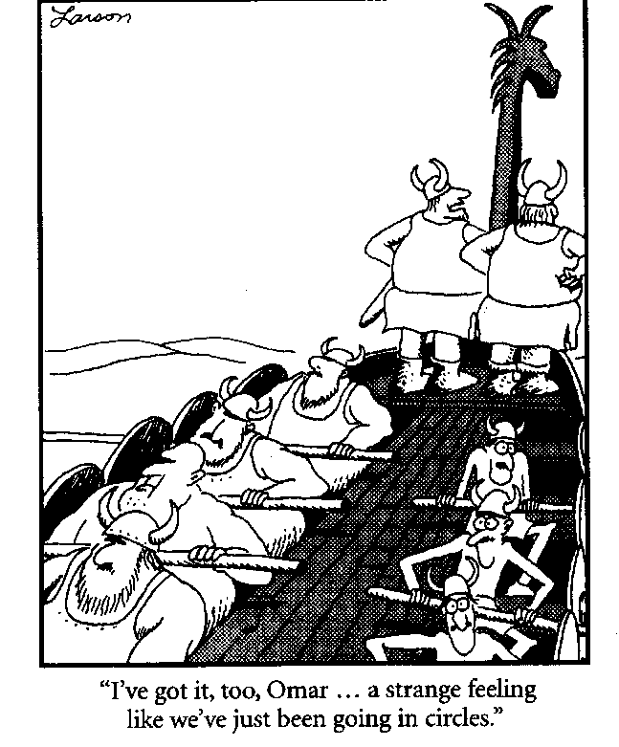

Slide 50
OARS: Open Ended Questions
Cannot be answered yes or no or with one or two words
Are not rhetorical
Probe widely for information
Help uncover the individual’s priorities and values
Avoid socially desirable responses
Draw people out

Slide 51
Closed vs. Open Ended Questions
Closed ended | Open ended
Would you like to quit smoking? | What are your thoughts about smoking?
How much pot do you smoke? | Tell me about your pot use.
Have you had problems with your alcohol use? | How has your alcohol use affected you?
Providers tend to ask close-ended questions to collect specific information and also because they are often pressed for time and concerned about getting into time consuming discussion.
Open-ended questions may seem more time consuming but can actually be more efficient because they elicit more reliable and complete information and, when skillfully managed, do not have to lead to lengthy discussions.

Slide 52

OARS: Affirmations
Affirmations can help your patients feel more comfortable, forthcoming and open to feedback. Affirmations can be brief but powerful in building a therapeutic alliance:
Affirm a person’s struggles, achievements, values, and feelings
Emphasize a strength
Notice and appreciate a positive action
Express positive regard and caring
Examples
  It takes courage to face such difficult problems.
  You quit before. That took a lot of strength.
  I know you didn’t come here today to talk about your alcohol use so I think it is great that you are willing to work with me.

Slide 53
OARS: Reflections
Reflections repeat or rephrase what the patient has said. This communicates that you have heard the person and that it is not your intention to get into an argument with the person.
Simple reflections are an effective, non-confrontational way to reduce resistance. Reflections can also expand on the meaning of what the patient has said.
Example:
Patient: But I can't quit drinking. I mean, all of my friends drink!
Provider: Quitting drinking seems nearly impossible because you spend so much time with others who drink.
Patient: Right…. But maybe I should cut down a little.

Slide 54

Universal Safe Reflections
It sounds like you are feeling……..
It sounds like you are not happy with….
It sounds like you are having trouble with…..
So you feel like..
You’re wondering if…
In other words, you’re saying….
Let me see if I heard you correctly….
What I hear you saying is…

Slide 55
OARS: Summarization
Summarization brings closure, affirmation and consensus to what has been discussed and next steps.
Examples:
What you’ve said is important.
I value what you say.
So, what I think you are saying is….. Did I hear you correctly?
We covered that well. Now let's talk about ...
Notes:
71

Slide 56
TECHNIQUES: Eliciting Change Talk
Change talk is patient speech that favors movement in the direction of change such as when the patient:
Recognizes the problem
Expresses concern
Expresses awareness
Sees the benefits of change
Sees the cost of not changing
Change talk increases the chances that your patient will make actual changes.

Slide 57
How to Elicit Change Talk
Change talk can be elicited with strategic questions:
By probing for elaboration and examples:
Examples:
What are some of the pros and cons of drinking?
How would you like your life to look a year from now?
How would things be different if you stopped using?
You have quit before. What made that work for you then?
Examples:
Tell me more about how this is affecting your family life.
You want to be a good student but smoking pot sometimes leave you foggy. Can you tell me more about that?
You mentioned that cost is one negative consequence of your drinking. Can you think of any more negatives?
Notes:
Let’s look at each of these strategies briefly. You have seen some of them and others are new. This will put it in a nice format for you to remember.
I am also handing out another ‘cheat sheet’ to put on the wall with the one about reflections! This will help when you aren’t sure where to do with someone.
Go through the three ECT slides swiftly. See modeling instructions next page.

Slide 58
Techniques: Generating Commitment
Generating commitment should follow closely after a patient begins to talk about change.
Formulating an action plan – even if the first steps are small – helps to translate thought into commitment and actual behavior change.

Slide 59
Help the patient formulate SMART goals based on his/her readiness to change:
Specific Measurable Attainable Realistic Time limited
  The goals could be as simple as counting drinks or reading. The important thing is that the patient do something that will raise awareness and build commitment.
  Make a plan to follow up and check with the patient on how they are doing. Accountability helps build commitment.

Slide 60
5. Negotiate a plan
Summarize the discussion
Discuss a menu of optional SMART goals:
  Keep track of substance use
  Read informational materials provided or available online
  Set a short term goal to cut down
  Even if the patient doesn’t want to address the problem now, reinforce any positive action (e.g., willing to discuss it).
  Negotiate but emphasize patient autonomy and control:
  We are talking about your health. This is your decision.

Slide 61

Take Home Points
Changing behavior is hard. Most of us don’t have to look any further than ourselves to understand that and find compassion for our patients.
Brief education offers an evidence based framework and structure to help your patients make difficult changes.
Brief education tools and techniques are like surgical instruments that can be selected based on circumstances to promote behavior change.

Slide 62
Practice Instructions and Closing
Blue Folders pair up with Beige Folders
Blue – Blue and Beige - Beige pairings are illegal in Missouri.
Each folder contains three sets of forms:
  One complete set of all forms to take back to your clinics to copy and use when all else fails!
  One set of blank forms for the provider to complete in a brief education including the PFR
  One set of completed forms for the patient to use in responding to provider queries that will generate a BE.

Slide 63
Two scenarios representing what you will see most often:
  BE level alcohol use
  BE level alcohol + marijuana use
  Blues will go first as providers using the blank set with the PFR. Beiges will be the patient using the completed forms in their folders. (Stop at 25 minutes)
  Reverse roles. Beiges will be the provider using the blank set in their folders with the PFR. Blues will be the patient using the completed forms in their folders. (Stop at 25 minutes).
  Regroup for debriefing, closing and evaluation forms
  Remember to ………..

Slide 64
Stick to the Five Steps and Keep it Moving
Brief intervention
1. Raise the subject
2. Provide feedback
3. Offer Advice
4. Enhance motivation
5. Negotiate a plan

