Slide 1


Missouri Institute of Mental Health
Asking the Questions:
The First Step of the MOSBIRT Protocol
Rita Adkins, MPA

Slide 2
Seven Word Sentence:
Change
Needed
The
For
Is
Today
Time

Slide 3
Seven Word Sentence:
Needed
The
Change
For
Is
Today
Time
Time is needed for the change today.

Slide 4
Why do we need training?
Can be summed in one word:
STANDARDIZATION

Slide 5
Three Goals of Standardization
Each patient is exposed to the same question experience
All answers are recorded in the same manner
Any differences in answers should be directly attributable to differences between individuals, not to differences in the process that produced that answer
Notes:
Any program is only as good as the data that are collected!

Slide 6
Before asking the questions
Understand the distinction between screening and assessment:
      Screening is not to diagnose AOD abuse
      Screening identifies patients at risk for AOD problems
Talk with the patient about the purpose of the questions and how the results will be used
Notes:
I’m a member of your tx team and I’m going to aks you some questions about your health habits. Anything you tell me is confidential, as we follow HIPAA rules. You can skip any question you don’t feel comfortable answering. There are no right or wrong answers, but how you feel rather than how much you know about any subject. Important to not mention substance use in your intro as it may bias their answers later.

Slide 7
Before asking the questions
Understand you have multiple responsibilities:
First:
Ask the screening questions to determine if the patient is at risk and qualifies for an Intervention
Then:
If the patient is at risk, use your MI skills to administer appropriate Intervention

Slide 8
MOSBIRT Evaluation
Is an important component of MOSBIRT
Ensures we achieve valid and reliable data
  By asking the patients questions from the standardized questionnaires
  By asking and recording the questions in a standardized manner
Notes:
We live in an era of accountability. Need to support programs is increasing, funding is decreasing. We need to evaluate MOSBIRT to determine if the money invested has been wisely spent. The evaluation component of MOSBIRT helps us prove to the funders that we are making a difference.

Slide 9
Before Meeting with the Patients
Practice, Practice, Practice!
Understand Purpose of the Questions
Have Supplies, including Scale Cards

Slide 10
First Contact
Give your name, and introduce yourself as a member of their treatment team
Do not ask questions that may elicit undesired responses—Assume patient is willing to answer questions
Remind the patient about confidentiality
Respect the patient’s right to say “No”

Slide 11
Avoid Creating Interviewer Bias
Do not offer your own opinion during the interview
Do not display approval or disapproval through your tone of voice, facial expression, or side comments
Do not discuss your own experiences with the patient
Do not read questions using your own words instead of those written on the screen
Notes:
The health coach can influence answers consciously or unconsciously through the use of verbal and non-verbal cues. Avoid giving clues to your own expectations, values or experiences that could lead to a biased response.

Slide 12
When asking the questions you must:
Read questions exactly as they are worded on the screen
Read question in the order in which they are presented with no additions, deletions or substitutions
Ask every question on the screen
Record answers accurately
You are a source of error if you don’t follow these steps!
Notes:
If you change the meaning or wording of the ?’s, the V&R of the responses would be affected, making it difficult to compare the responses.

Slide 13
Keeping Patient on Track
When patient wanders off track:
Don’t attempt to reword a question or instruction guidelines
Do not share your own experiences
Do not answer personal questions
Use neutral non-verbals to encourage appropriate response
Notes:
It is not uncommon for interviews to wander off course, and for you to spend a lot of time talking about things that will ultimately not be useful to you in your study. Don't let this turn into a chat. You want to be friendly and courteous, but you also have a task to do. To steer your interviewee back after a digression, try pushing on how the digression happened in the first place. Try questions like these:

Slide 14
Keeping Patient on Track
Key phrases that may be used when the patient asks for more information:
“This is all the information available to us.”
“We would like you to answer the question in terms of the way it is stated.”
“Could I read it again for you?”
“I’m sorry, I don’t have that information.”
Notes:
It is not uncommon for interviews to wander off course, and for you to spend a lot of time talking about things that will ultimately not be useful to you in your study. Don't let this turn into a chat. You want to be friendly and courteous, but you also have a task to do. To steer your interviewee back after a digression, try pushing on how the digression happened in the first place. Try questions like these:

Slide 15
Keeping Patient on Track
Key phrases that may be used when the patient digresses:
“Let me get that down, and we can talk about that when we finish with the questions.”
“I see, but have you(repeat the question)”
“We have touched on this before, but I need to ask every question in the order that it appears in the questionnaire.”
Notes:
It is not uncommon for interviews to wander off course, and for you to spend a lot of time talking about things that will ultimately not be useful to you in your study. Don't let this turn into a chat. You want to be friendly and courteous, but you also have a task to do. To steer your interviewee back after a digression, try pushing on how the digression happened in the first place. Try questions like these:

Slide 16
Interviewing Tips: When asking the questions, keep in mind:
Read each of the responses on the response cards.
When reading a list, repeat the question stem every third response choice.
Emphasize underlined words.
Do not read bolded text.
Notes:
As a reminder:

Slide 17
Three Goals of Standardization
Each patient is exposed to the same question experience
All answers are recorded in the same manner
Any differences in answers should be a direct result of differences between individuals, not to differences in the process that produced that answer

Slide 18

MOSBIRT Instruments
Rita Adkins, MPA
Missouri Institute of Mental Health

Slide 19
Objectives
To understand the purpose and use of each instrument
To get familiar with items in each instrument

Slide 20
The Instruments used for MOSBIRT
Prescreen
ASSIST
GPRA (will be introduced separately)
AUDIT-C
Mental Health Screening Test
Readiness to Change Ruler
ATOD Beliefs and Attitudes
Patient Satisfaction Survey

Slide 21
Prescreen
A total of 5 questions regarding the use of tobacco, alcohol, and drugs.
Drugs include prescription drugs for other purposes.
A different criteria for male and female patients regarding alcohol use.
Administered by medical staff at some sites.
One YES in item 2 thru 5 means that the patient requires a full screening – ASSIST & Appropriate GPRA Sections

Slide 22
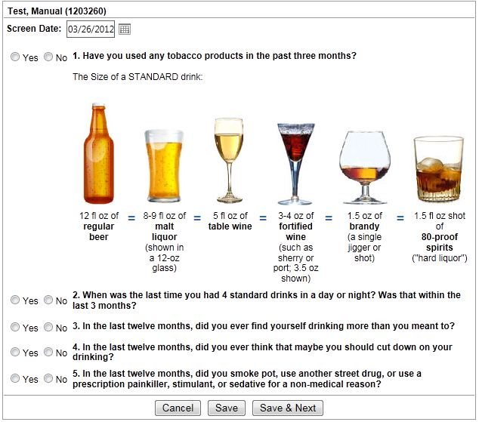
Prescreen

Slide 23
ASSIST
The WHO Alcohol, Smoking, and Substance Involvement Screening Test
The full screening test in MOSBIRT
8 questions covering 10 main substance groups
Total scores are calculated with items 2 through 7 for each substance group endorsed
The level of treatment is determined by total scores
The Alcohol and Drug Scores are recorded in GPRA section A

Slide 24
A.S.S.I.S.T. (cont.)
Criteria for the level of treatment
ASSIST Total Scores | The Level of Risk | Treatment
0-10 for Alcohol 0-3 for Drugs | Low risk | No Treatment
11-19 for Alcohol 4-19 for Drugs | Low moderate risk | Brief Education
20-26 for Any Substance | High moderate risk | Brief Coaching
27 + for Any Substance | High risk | Referral to Treatment

Slide 25
What is GPRA?
GPRA = Government Performance and Results Act
Is a federal law enacted in 1993.
Shows Congress how the MOSBIRT is performing based on a set of specific measures.
Information that is reported to Congress must be backed up by a data supported audit trail that can be verified and validated.

Slide 26
What Does This Mean for MOSBIRT?
Requires all SAMHSA projects providing services to individuals to collect a uniform set of data elements at intake to services and 6 months post intake on 10% of those receiving services
We must obtain 80% follow-up rate on random sample of those receiving services

Slide 27
How is the SBIRT GPRA Tool Used?
Questions in the tool must be asked as written
  Do not assume any answer—ask all questions
  Record answer given by patient
The tool is used for program reporting only
No patient-identifying information is collected or reported
Read ALL response sets in lower cased font
Response sets in upper case font should NOT be read
  Ask these questions as open-ended
  Record the response based on patient’s answer

Slide 28
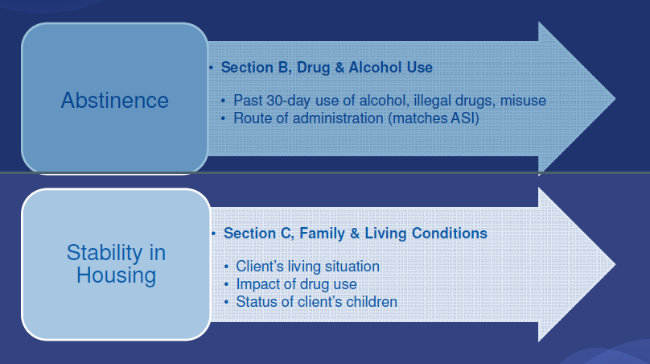
What Does GPRA Measure?
National Outcome Measures (NOM’s)

Slide 29
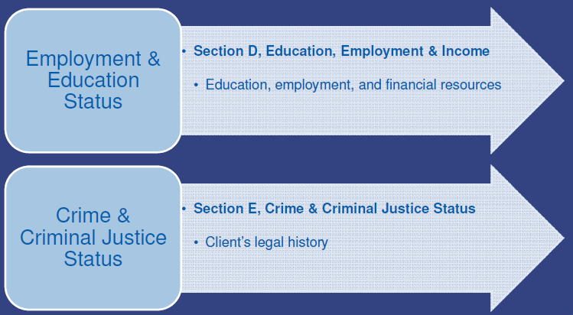
What Does GPRA Measure?
National Outcome Measures (NOM’s)

Slide 30
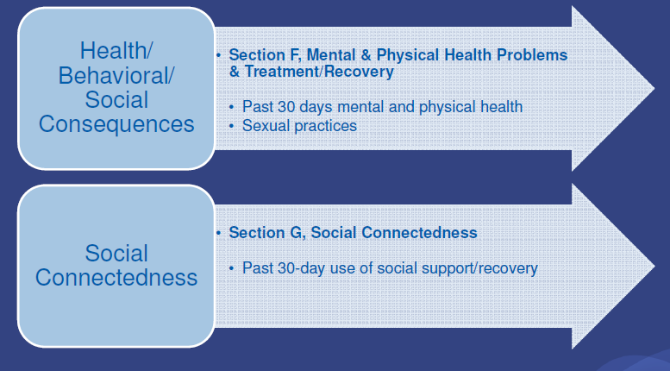
What Does GPRA Measure?
National Outcome Measures (NOM’s)

Slide 31
What Data are Collected?
Required Sections of Data Collection Tool
    Screening Only – Section A
    Brief Education Patients — Sections A & B
    Sampling for follow-up interviews (10%)
    Brief Coaching and Referral Patients — Sections A-G
    Sampling for follow-up interviews (10%)

Slide 32
Alcohol Use Assessment-C
3-item alcohol screen to identify risky drinkers or those with active alcohol use disorders
Scored on a scale of 0-12
Generally the higher the score, the more likely risky drinking is involved.

Slide 33
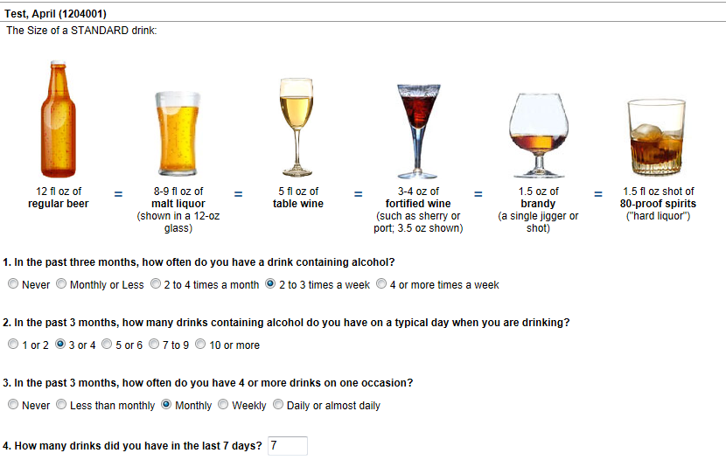
Alcohol Use Assessment-C

Slide 34
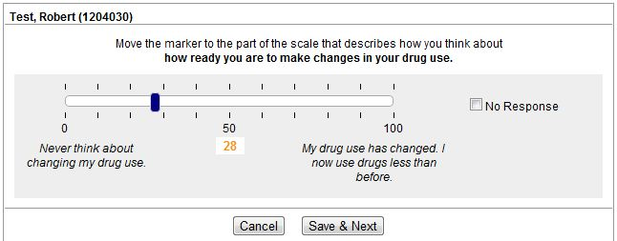
Readiness to Change Slider
Notes:
No maintenance

Slide 35
Mental Health Screen
Looks for co-occurring problems
The mental health screen consists of questions 2, 5 & 6 from the GPRA Section F
Provides mental health service information

Slide 36
ATOD Beliefs and Attitudes Scale
Center for Substance Abuse Prevention (CSAP) GPRA Attitudes and Beliefs Regarding Substance Use – Adult (2005)
ATOD – Alcohol, Tobacco, and Other Drugs
8 questions about how the patient feels about the use and risks associated with ATOD

Slide 37
Patient Satisfaction Survey
It is important to understand the level of patients’ satisfaction with MOSBIRT
The feedback informs us of the areas needing improvement
Patients will complete the survey without assistance from the health coach

Slide 38
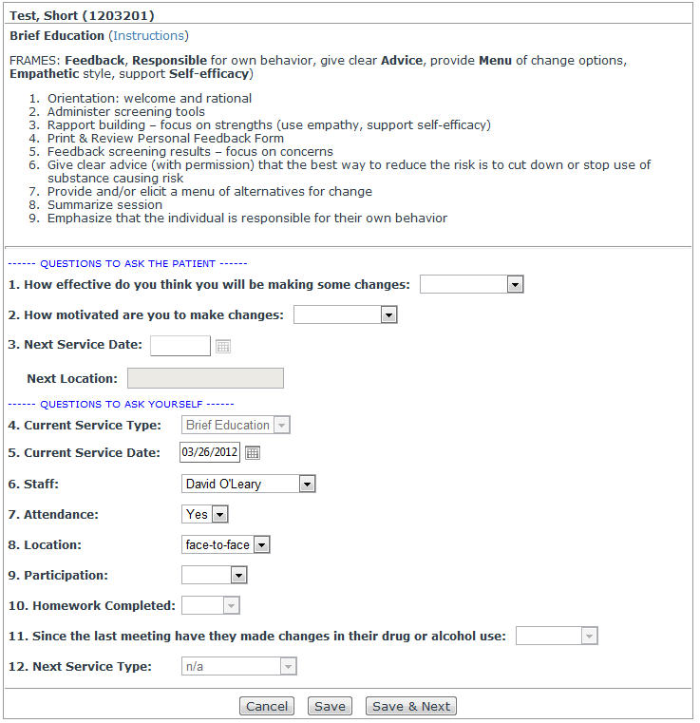

Slide 39
Follow-Up Window Period
The window for 6 month follow-up is 30 Days before and 60 Days after the 6 month anniversary of the intake date.

Slide 40
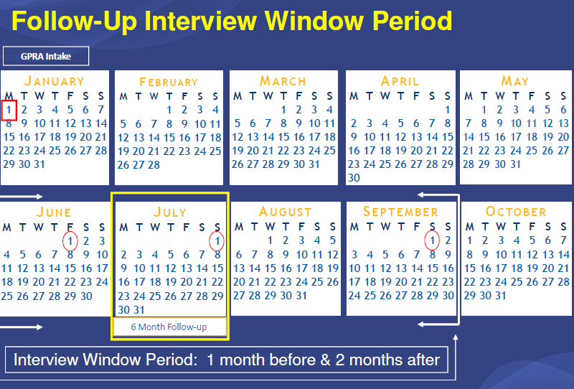

Slide 41
Locator Form
Developed based on Tracking database fields
Information forwarded to tracker for entry into web-based tracking database
Has consent to contact individuals/agencies listed, must be signed by patient
Paper copy to be kept in participant folder

Slide 42
Good Follow-Up Requirements
Never mention substance use or treatment study
Do not divulge confidential information
Keep information under lock and key
      Double locked
Make interview experience positive

Slide 43
Lessons Learned from Other SBIRT Programs
Get Full name, DOB, SSN
Prior Addresses
Places they frequent
Places of employment
Agencies they use, i.e. Social Services, ADA services, etc.

Slide 44
Lessons Learned from Other SBIRT Programs
Get as much contact information as possible
    Closest female relative
    Closest friend
    Church/Pastor
    Nicknames, street names
    Name of Dr., pharmacy used
If homeless,
      Where do you sleep when it is cold?
      Food Pantry

