Slide 1
eSBIRT ('ēz'birt)
eSBIRT (1.3.0) June 2012
Matthew G. Hile, PhD Missouri Institute of Mental Health

Slide 2
Characteristics
Web application written in .NET on a DotNetNuke platform
Designed to support
Multiple computers
Multiple users
Multiple locations
Multiple sites
Data stored in an encrypted database on our server
Walks BHC (with patient) step-by-step through the MOSBIRT process

Slide 3
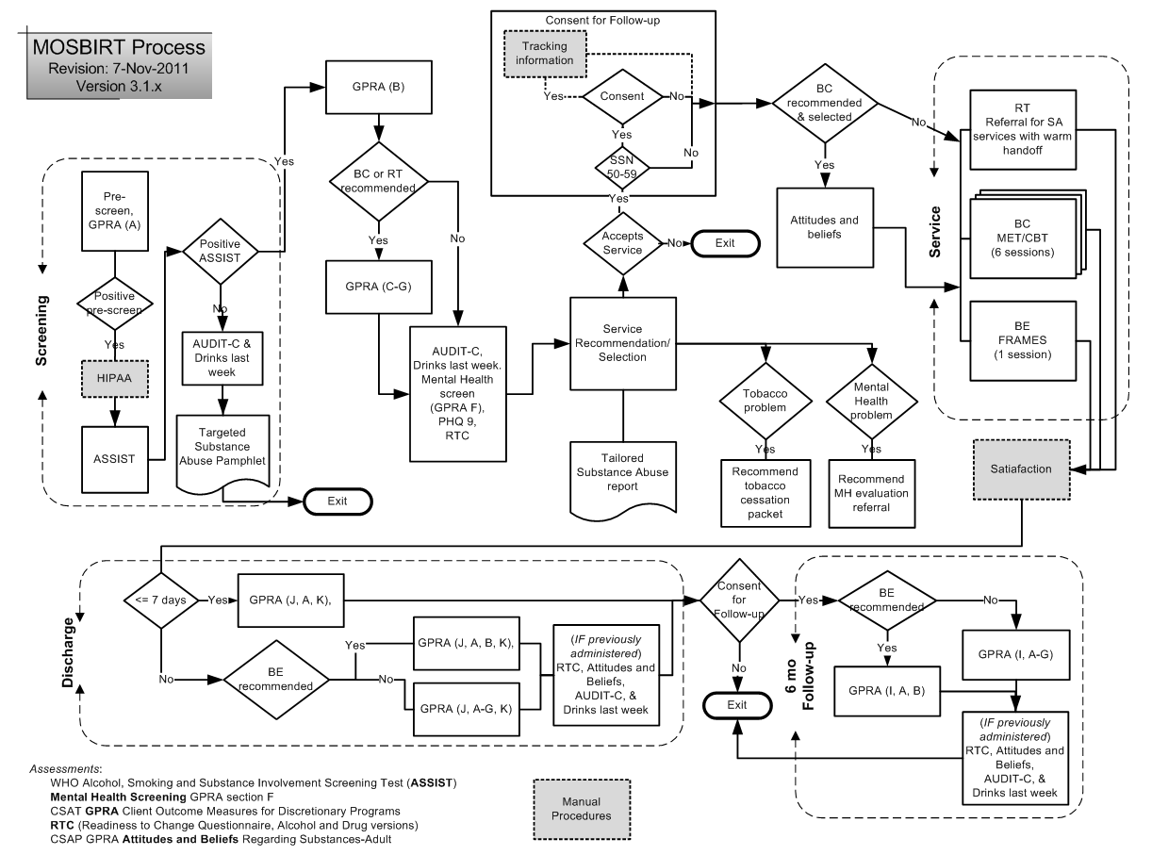
What does eSBIRT do?

Slide 4
Security (the onion model)
Data
Encrypted Database
eSBIRT Password
SSL

Slide 5
System requirements
Connection to internet (wired or wireless)
Tested browsers
Chrome
Firefox
IE (versions 8 and 9)
Also tested on 10 inch tablets (e.g. Samsung Galaxy Tab 10.1 and Apple iPad)

Slide 6
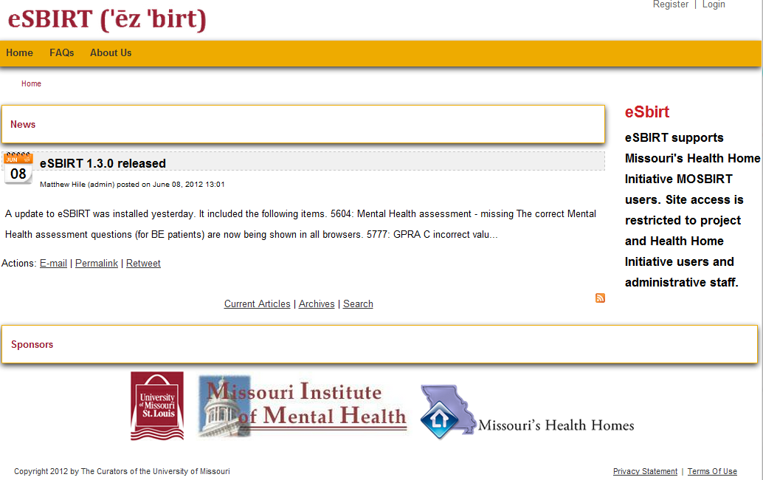
eSBIRT.org

Slide 7
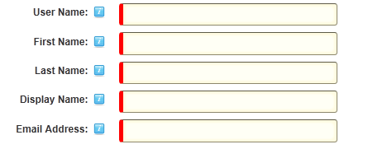
Registration Process
Register
We will check your name on the list and authorize your access.
You will get an email when that is done.

Slide 8
Password
Requirements
Nine characters
Upper case (at least one)
Lower case (at least one)
Number (at least one)
Special character (at least one)

Slide 9
The Password Haystack
“Rd$3Q”
Offline attack 0.08 sec
7,820,126,495
“bad……….”
Offline attack 340 yrs
106,782,520,911,927,817,025,219
Takeaway
Length is your friend
https://www.grc.com/haystack.htm

Slide 10
Good Passwords
Long
Multiple character types
No dictionary words
Easy to remember (sure!)
eSBIRT trainees are ready to rock and roll!
eSBIRT Trainees are ready 2 rock + roll!
eTar2r+r!

Slide 11
MOSBIRT Flow
Identify patient
Prescreen
ASSIST
Additional measures
GPRA sections (as required)
Readiness To Change (drug and/or alcohol)
Attitude questionnaire (as required)
Share Personalized Feedback Report
Agree on Service
Permission to follow (if appropriate)
Provide Service
Discharge with GPRA sections (as needed)

Slide 12
Searching & Entering Patient

Slide 13
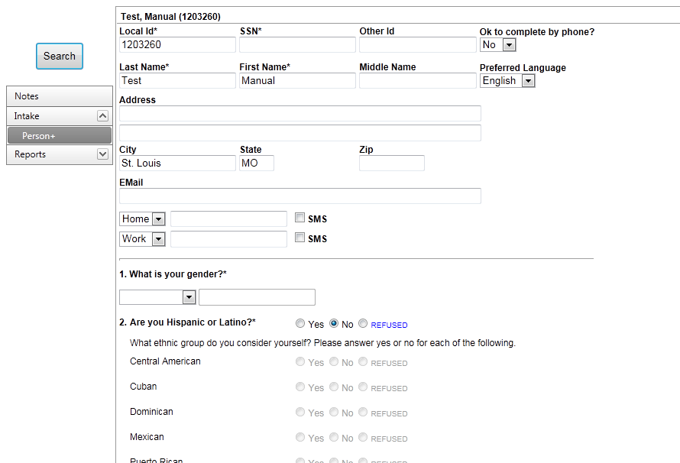
Person

Slide 14
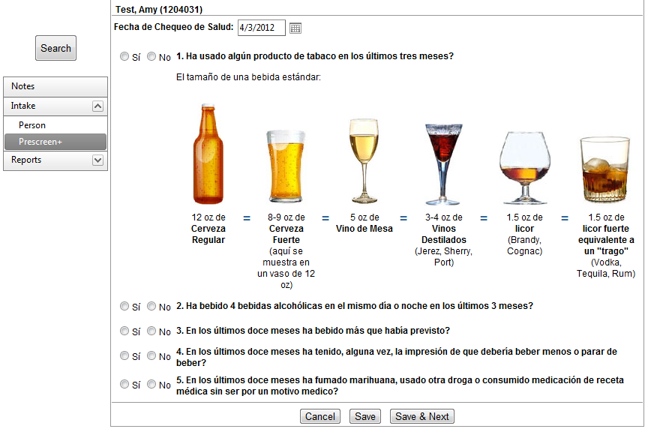
Prescreen

Slide 15
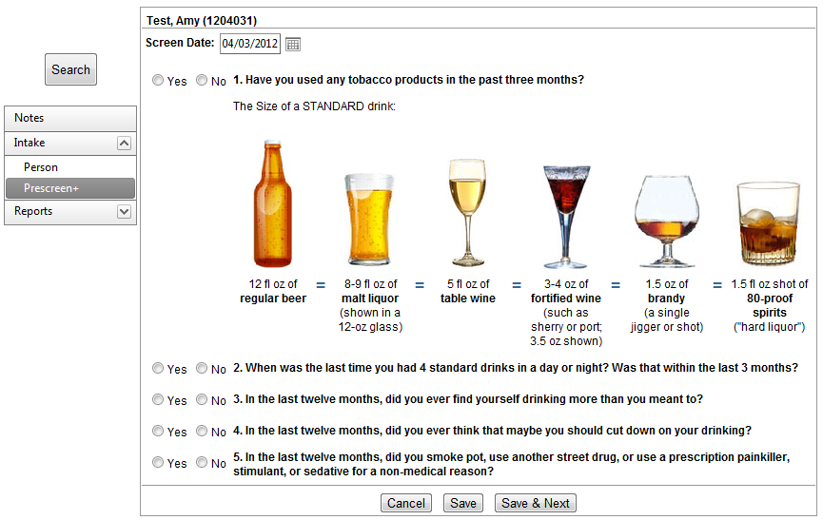
Prescreen

Slide 16
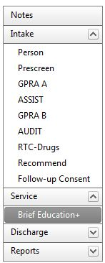
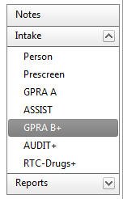
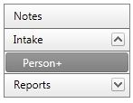
MOSBIRT Menu

Slide 17
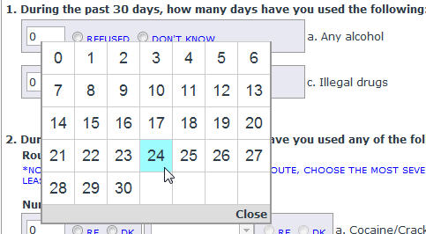
Quick number entry

Slide 18
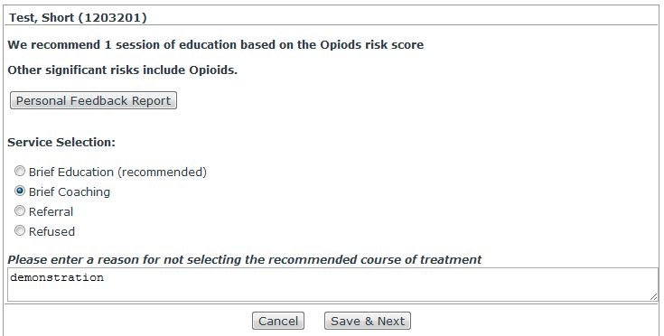
Recommendation

Slide 19
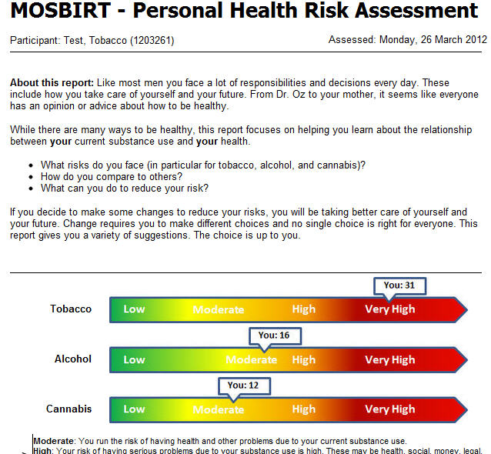
Health Risk Assessment

Slide 20
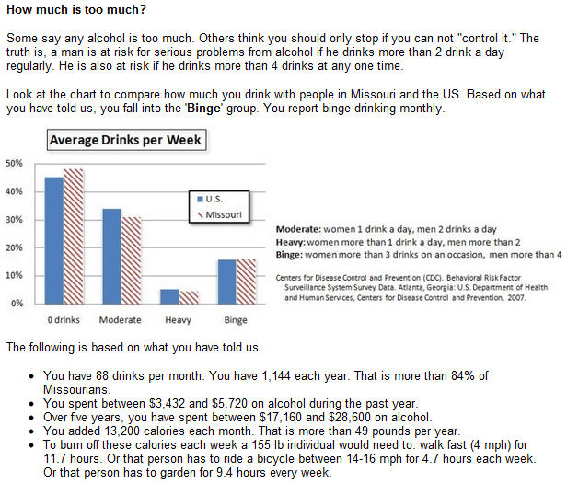

Slide 21
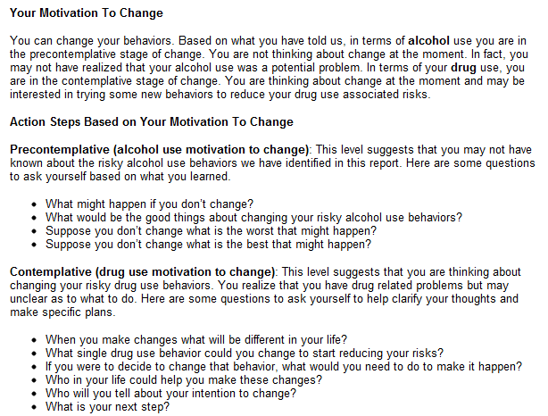

Slide 22
Recommendation

Slide 23
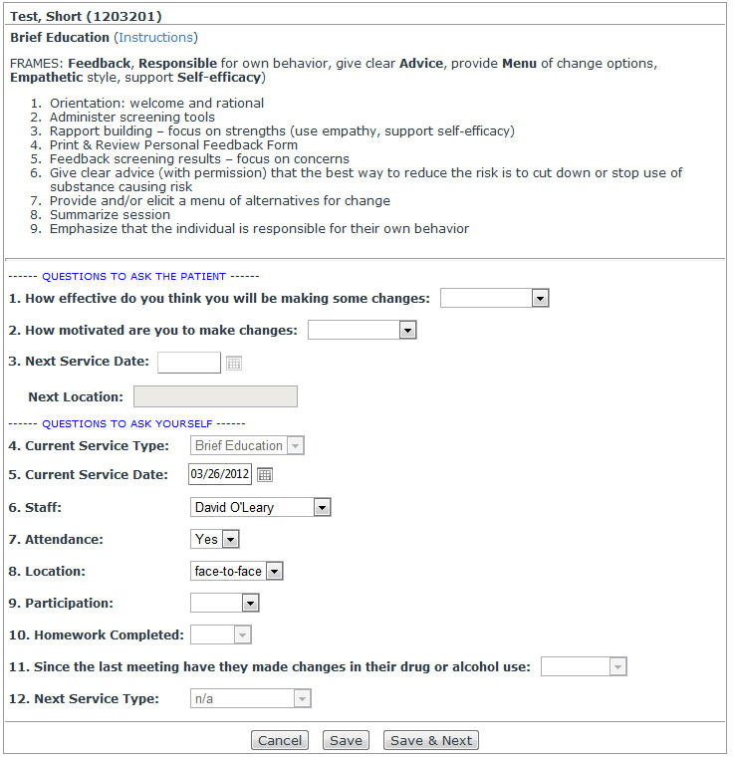
Sessions

Slide 24
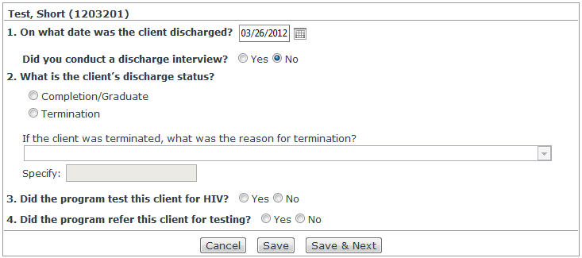
Discharge

Slide 25
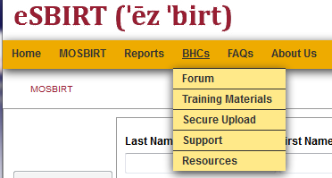
eSBIRT.org Features

Slide 26
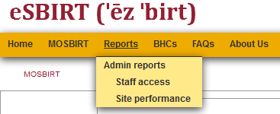
Report - Security

Slide 27
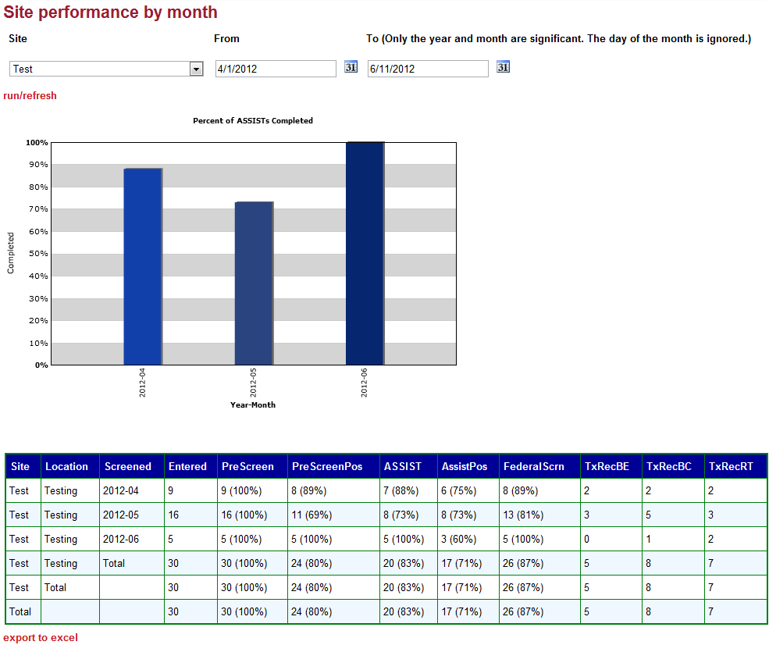
Report – Site Performance

Slide 28
Report - Site Performance

Slide 29
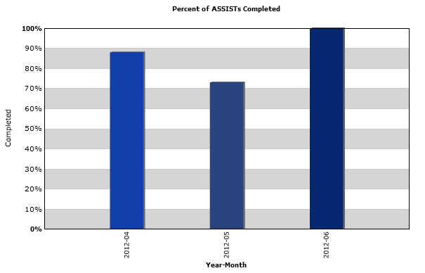
Report - Site Performance

Slide 30
Report - Site Performance

Slide 31
Help
Talk to co-workers and supervisor
FAQs
eSBIRT forum
Local IT support (hardware and connections)
Contact Sean, Keith, or Matthew
Sean.Power@mimh.edu (314-877-6403)
Keith.Eldridge@mimh.edu (314-877-6437)
Matthew.Hile@mimh.edu
Twitter (Follow MOSBIRT)

Slide 32
This has been an MIMH production

