Slide 1
Behavioral Management of Anxiety & Depression in Primary Care
C. Alec Pollard, Ph.D.
Saint Louis University and Saint Louis Behavioral Medicine Institute

Slide 2
Case #1
27 year-old single woman, working full-time in marketing
Complaint: 2 months ago, began having “spells” (light-headed, heart racing, difficulty breathing) that came “out of nowhere”. Worries she’s having a heart attack. Hesitant to go places alone. 2 trips to ER, negative for cardiac problems. Given short-term Rx for Alprazolam, told to see PCP.
Prior TX: none, other than the ER

Slide 3
Case #2
55 year-old married man, works for accounting firm, on medical leave for past 2 weeks
Complaint: “Tired all the time,” “hopeless,” stopped doing anything “I don’t have to do,” “sleeping too much,” worried he might lose his job. Wife “gets on my case.” Sometimes “I wish I was dead.”
Prior TX: 3 trials of SSRI; currently on Lexapro 20 mg; psychotherapy for 2 months, but it “didn’t work.”

Slide 4
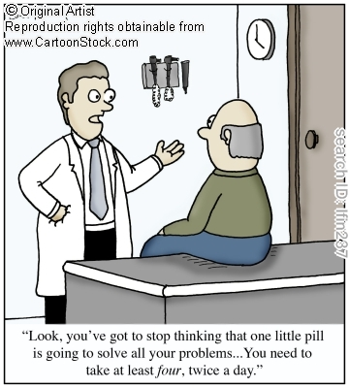

Slide 5
DIAGNOSIS

Slide 6
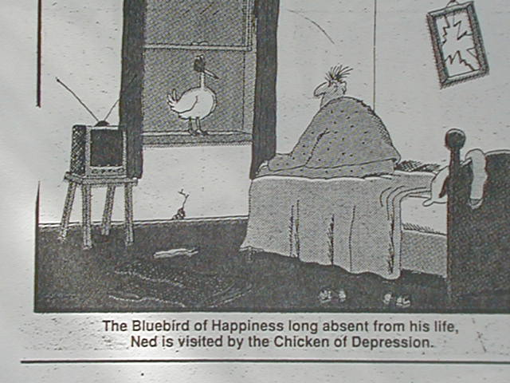

Slide 7
DEPRESSION (Unipolar)

Slide 8
DSM-IV Diagnostic Criteria
A. #1 or #2 plus at least 4 more of the following during
a 2-week period:
Depressed mood
Diminished interest or pleasure
Weight loss or gain
Insomnia or hypersomnia
Psychomotor agitation or retardation
Fatigue
Feeling worthless or excessive/inappropriate guilt
Diminished ability to think, concentrate, or make decisions
Thoughts of death or suicidal ideation

Slide 9
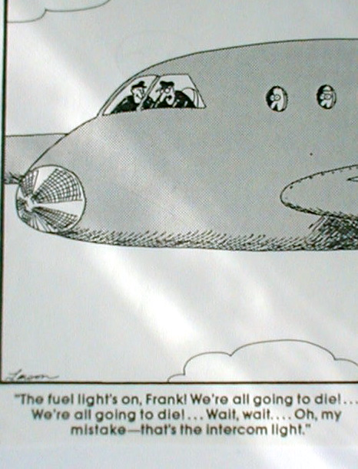

Slide 10
THE ANXIETY DISORDERS

Slide 11
Anxiety Disorders
Generalized Anxiety Disorder
Panic Disorder/Agoraphobia
Social Anxiety Disorder
Obsessive-Compulsive Disorder
Posttraumatic Stress Disorder
Specific Phobia:
Blood Injection Injury Phobia

Slide 12
Primary, Distinguishing Symptoms of the Major Anxiety Disorders
SYMPTOM
1. Panic attacks
2. Fear/Avoidance of:
a. panic/symptom attacks
b. social situations/
performance
c. needles, blood, etc.; plus
fainting
4. Obsessions, compulsions
5. Worry
6. Flashbacks, nightmares, etc.
DISORDER
Panic Disorder
2. Phobia
a. Agoraphobia
b. Social Phobia
c. Blood/Injection/Injury Phobia
4. Obsessive-Compulsive Disorder
5. Generalized Anxiety Disorder
6. Posttraumatic Stress Disorder

Slide 13
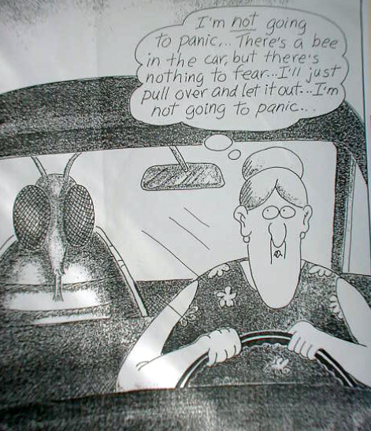

Slide 14
SCREENING

Slide 15
Limitations of Screeners
Some are comprehensive, but take too long to fill out
Some are brief, but only screen for limited # of problems

Slide 17
Primary Care Behavioral Health Screener Developed by the Integrated Care Team at Saint Louis Behavioral Medicine Institute

Slide 19
Problems Possibly Indicated by Individual Screener Items

Slide 20
PSYCHOSOCIAL TREATMENT OF ANXIETY & DEPRESSION ------------------- An Review of Evidence-Based Treatment (E-BT)

Slide 21
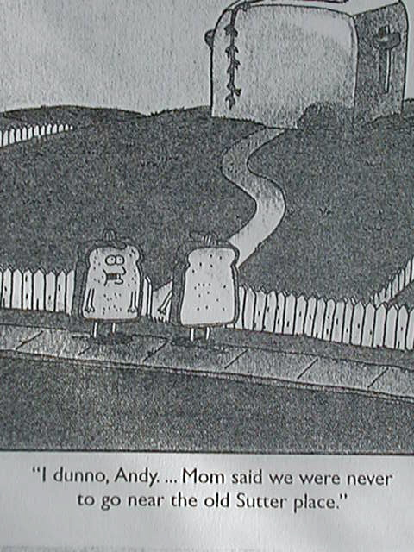

Slide 22
E-BTs for Depression
Behavior Therapy (BT)
Cognitive Therapy (CT)
Interpersonal Psychotherapy (IPT)

Slide 23
Behavior Therapy (Behavioral Activation)
Depression is caused by deficiencies in frequency or quality of positive reinforcement.
Treatment includes social skills training, problem-solving, & activity scheduling to improve access to pleasurable activities.

Slide 24
Cognitive Therapy
Depression is caused by negative, faulty beliefs about the self, the world, and the future.
Treatment includes examination of experiential evidence, behavioral experiments, thought monitoring, and Socratic questioning to modify faulty beliefs.

Slide 25
Conclusions: Depression TX
Short-term outcome:
CT = BT = IPT = Antidepressants
Long-term outcome:
Psychotherapies superior
Very Severe Depression
- Behavioral Activation may be superior to
CT & IPT
- Drug & Psychotherapy may be superior

Slide 26
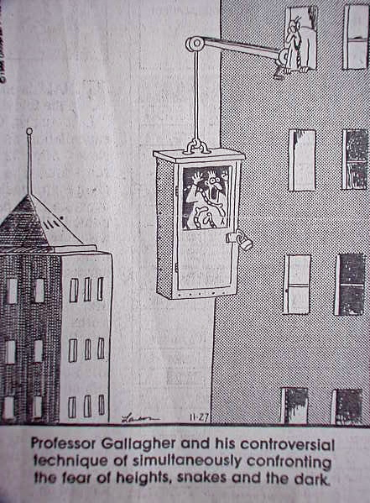
Professor Gallagher and his controversial technique of simultaneously confronting the fear of
heights, snakes, and the dark.

Slide 27
E-BTs for Anxiety Disorders
Cognitive Behavior Therapy
Specific protocols for each anxiety disorder
However, all share common components

Slide 28
Common CBT Components for all Anxiety Disorders
Education about the disorder and the treatment model
Cognitive intervention (identifying misappraisals of threat)
Teaching adaptive (non-avoidant) coping
Exposure to feared situations

Slide 29
Conclusions: Anxiety Disorder TX
CBT effective, superior to credible placebos
CBT vs Drug Tx
Short-term: equivalent
Long-term: CBT superior
CBT & Drug Tx
No general advantage in pts willing to do either tx
Advantageous in CBT-refusers/non-responders
Drugs may uniquely interfere with CBT in PDA
CBT may reduce relapse after drug discontinuation

Slide 30
ADAPTING TREATMENT TO THE PRIMARY CARE SETTING

Slide 31
Specific Adaptations
Use of self-help resources
- Local (e.g., support groups)
- National (e.g., books, organizations such as
ADAA, IOCDF, DMDA)
Use extenders (PCP, family)
Maximize use of direct contact
Supplement individual BHC contacts (e.g., telephone, group)
Menu approach: matching tx to patient
Use tx models compatible with primary care

Slide 32
A unified approach that can be applied to anxiety and depression: The LEAP Intervention Adapted for primary care from The Unified Protocol : Allen, McHugh, & Barlow (2008). In D.H. Barlow (Ed.), Clinical handbook of psychological disorders (4th Ed.), New York: The Guilford Press.

Slide 33
Rationale for a Unified Approach
Anxiety & Depression (Emotional Disorders)
Shared etiology
Shared features (e.g., avoidance, faulty beliefs, coping deficits)
Co-morbidity
E-BTs have common components

Slide 34
4 Treatment Components
Psychoeducation
Antecedent Cognitive Reappraisal
Prevention of Emotional Avoidance
Modifying Emotion-Driven Behavior

Slide 35
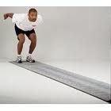
LEAP
Learn about your problem
Examine your thinking
Accept and manage your feelings
Perform new behavior at your own pace

Slide 36
1. Learn About Your Problem
Teaching patients about the nature of their disorder and the treatment model.
In English:
“Learning about your problem and the treatment we use to fix it.”

Slide 37
Content of Psychoeducation
Emotions serve a purpose. They provide information.
Although uncomfortable, they do not need to be avoided.
Avoiding negative emotions can interfere with life and make things worse in the long run.
Emotions have 3 parts: thoughts, feelings, & behavior
A change in 1 of the 3 can change the other 2
You have the most control over your behavior, so that will be the main focus of our efforts

Slide 38
Avoidance Behavior is Maintained by Negative Reinforcement
Reinforcement increases response frequency
2 types of reinforcement:
positive: starting something pleasant
negative: stopping something unpleasant
Reduction of an unpleasant emotional state is NR
NR reinforces maladaptive behavior in emotional disorders

Slide 39
A Thing I Want to Avoid
I Assume Something Negative Based
On a Misguided Notion
I Experience an Unpleasant Emotion
I Avoid the Thing or the Emotion
I Keep Responding Based on
a Misguided Notion

Slide 40
2. Examine Your Thinking
Cognitive interventions to modify misappraisals about the consequences of emotions.
In English:
“Change what you believe about the things you don’t feel like doing.”

Slide 41
Examples of Interventions for Step 2
Information gathering, education
Examining experiential evidence
Socratic questioning
Thought records
Behavioral experiments
Utility analysis

Slide 42
3. Accept & Manage Your Feelings
Teaching adaptive, non-avoidant coping
In English
“Learning strategies to deal more effectively with difficult situations.”

Slide 43
2 Types of Avoidance
Primary
Don’t go there!
Secondary
If you must go there, be sure and….

Slide 44
Examples of Secondary Avoidance
Compulsions
Use of safety signals
Suppressing “bad” thoughts
Distraction
Reassurance-seeking
Worry
Misuse of substances
Subtle behavioral avoidance

Slide 45
Examples of Interventions Used for Step 3
Relaxation training
Mindfulness
Coping statements

Slide 46
Tips for Step 3
Not doing the wrong thing is more important than doing the right thing
Provide them alternatives
Anything that interferes with avoidant coping could be helpful
Good coping strategies facilitate learning
Learning from it vs Surviving it

Slide 47
4. Performing New Behavior at Your Own Pace
Facilitating gradual exposure to previously avoided situations (antecedents). Acting in ways that are incompatible with the emotion.
In English:
“Starting to do things you don’t currently feel like doing, at a pace you can handle.”

Slide 48
Emotional exposure may be provoked by:
Physical sensations
Thoughts
External situations

Slide 49
Examples of Step 4
Depression: behavioral activation
SAD: exposure to social situations
PDA: provoking panic sensations in agoraphobic situations
OCD: touching “contaminated” objects
PTSD: re-experiencing memories of the trauma and re-approaching trauma-related situations
GAD: practicing problem-solving & decisions-making
BII Phobia: graduated exposure to needles & other medical stimuli

Slide 50
Anxiety & Depression Treatment: Short Cut
Help them put a plan together for gradually re-engaging in the life-enhancing activities they’ve been avoiding, then follow up.

Slide 51
Case #1
Diagnosis: Panic Disorder with Agoraphobia
Cleared medically
Provided brief education on PDA & Tx options
Showed connection between panic attacks & stressors
(for her – the upcoming wedding)
Encouraged her to read the Agoraphobia Workbook
Gave her the website address of ADAA (www.adaa.org)
Helped her establish a time for exposure exercises
Encouraged a trial of non-medication
Encouraged her to call each Monday, leave update
Made follow-up appt for 1 mo: patient doing well, no further intervention necessary

Slide 52
Case #2
Diagnosis: Major Depression
Education about depression and behavioral activation
Identified factors of work stress & conditions associated with aging (i.e., ED, hypertension, weight gain) which were addressed by PCP
Assessed suicide status and made safety contract
Recommended reading Overcoming Depression One Step at a Time.
Suggested PCP delay further medication changes till after trial of BA.
Developed weekly, very basic schedule based on BA principles
Asked him to call in, leave message each AM when he gets out of bed.
Made follow-up visit for 3 weeks: adherence/progress minimal: referred to mental health clinic for higher level of BA/marital counseling & psychiatric consultation.

Slide 53
Case Discussion: Q & A/Role Play

Slide 54
Contact Information
Saint Louis Behavioral Medicine Institute
1229 Macklind Avenue
St. Louis, MO 63110
Phone: 314-534-0200
Fax; 314-534-7996
Email: pollarda@slu.edu
Website: www.slbmi.com

